Slide 1
A Goal-Based Framework For Software Measurement
R.Charanya, Assistant Professor,SITE, VIT Unniversity.

Slide 2
Objective
Classification of measures as process , product or resource ,and identify the attribute is internal or external.
Goal-Question-Metric(GQM)-measurement to the overall goals of the project and process.
R.Charanya, Assistant Professor,SITE, VIT Unniversity.

Slide 3
Goal Based Measurement
■ The primary question in goal-based measurement:
■ “What do we want to know or learn?”
instead of “What metrics should we use?”
■ Because the answers depend on your goals, no fixed set of metrics is universally appropriate.
■ Instead of attempting to develop general-purpose measures, one has to describe an adaptable process that users can use to identify and define measures that provide insights into their own development problem.
R.Charanya, Assistant Professor,SITE, VIT Unniversity.

Slide 4
GBM Process
Determining what to measure
  Identifying entities
  Classifying entries to be examined
  Determining relevant goal
Determining how to measure
  Inquire about metrics
  Assign metrics
R.Charanya, Assistant Professor,SITE, VIT Unniversity.

Slide 5
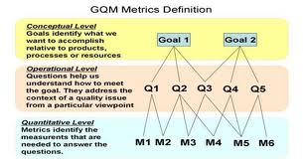

Slide 6
Identifying Entities
Process
Product
Resources
R.Charanya, Assistant Professor,SITE, VIT Unniversity.

Slide 7
Classifying Software Measures
In software there are three such classes
Processes: Collection of software-related activities.
Products: Artifacts, deliverables or documents that result from a process activity.
Resources: Entities required by a process activity.
R.Charanya, Assistant Professor,SITE, VIT Unniversity.

Slide 8
Internal and External Attributes
An internal attribute can be measured by examining the product, process, or resource on its own, separate from its behavior. (Program size, complexity, dependencies).
External attributes are those that can be measured only with respect to how the product, process or resource relates to the environment.
    (Experienced failures, timing and performance)
R.Charanya, Assistant Professor,SITE, VIT Unniversity.

Slide 9
Processes
We often have questions about our software-development activities and processes that measurement can help us to answer.
We want to know how long it takes for a process to complete, how much it will cost, whether it is effective or efficient, and how it compares with other processes that we could’ve chosen.
Example: AT&T developers wanted to know the effectiveness of their software inspections. In particular, managers needed to evacuate the cost of inspections against benefits received. To do this, they measured the average amount of effort expended per thousand lines of code reviewed. This information combined with measures of the number of faults discovered during the inspections, allowed managers to perform a cost-benefit analysis.
R.Charanya, Assistant Professor,SITE, VIT Unniversity.

Slide 10
Internal and External Attributes
Internal
Size, Effort, Cost
Code Complexity
Functionality
Modularity
Redundancy
Syntactic Correctness
Reuse
External
Usability
Integrity
Efficiency
Testability
Reusability
Portability
Interoperability
R.Charanya, Assistant Professor,SITE, VIT Unniversity.

Slide 11
Internal Process Attribute Directly Measured by
Internal process attribute directly measured by
  the duration of a process or one of its activities;
  the effort associated with the process or one of its activities;
  the number of incidents of a specified type arising during the process or one of its activities.
    Eg:-Ave. cost of error=cost/#errors_found.
R.Charanya, Assistant Professor,SITE, VIT Unniversity.

Slide 12
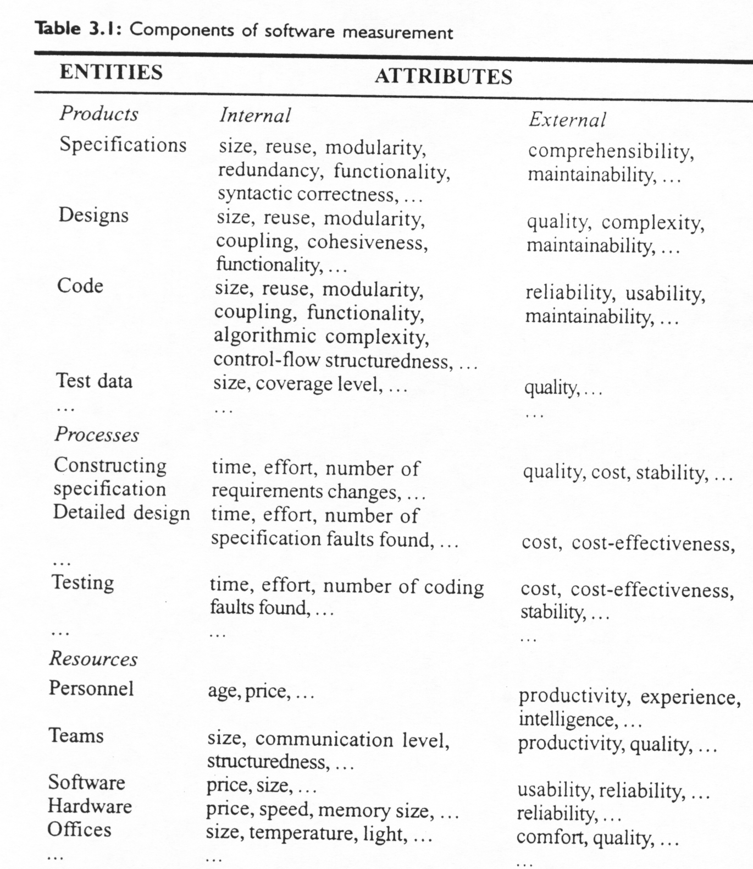
R.Charanya, Assistant Professor,SITE, VIT Unniversity.

Slide 13
Products
Products are not restricted to the items that management is committed to deliver to the customer. Any artifact or document produced during the software life cycle can be measured and assessed. For example developers often build prototypes for examination only, so that they can understand requirements or evaluate possible designs; these prototypes may be measured in some way.
R.Charanya, Assistant Professor,SITE, VIT Unniversity.

Slide 14
Products
External product attributes depend on both product behavior and environment, each attribute measure should take these characteristics into account.
External attributes:
  Reliability, maintainability, understandability (of documentation), usability, integrity, efficiency, reusability, portability, interoperability…
Internal product attributes are sometimes easy to measure. We can determine the size of a product by measuring the number of pages it fills or the number of words it contains. Other internal product attributes are more difficult to measure, because opinions differ as to what they mean and how to measured them. For example the complexity of codes.
Internal attributes
  Size, effort, cost, functionality, modularity, syntactic correctness.
R.Charanya, Assistant Professor,SITE, VIT Unniversity.

Slide 15
Product Measurements
Direct measure example:
  Entity: Module design document (D1)
  Attribute: Size
  Measure: No. of bubbles (in flow diagram).
Indirect measure example:
  Entity: Module design document (D1, D2,…)
  Attribute: Average module size
  Measure: Average no. of bubbles (in flow diagram).
R.Charanya, Assistant Professor,SITE, VIT Unniversity.

Slide 16
3.1.2.3.The Importance of Internal Attributes
Many software engineering methods proposed and developed in the last 25 years provide rules, tools, and any heuristics for providing software products. It is claimed that this structure makes them easier to understand, and tests.
It is assumed that good internal structure leads to a good external quality. This connection has rarely been established.
R.Charanya, Assistant Professor,SITE, VIT Unniversity.

Slide 17
3.1.2.4.Internal Attributes and Quality Control and Assurance
Major reason developer want to use internal attribute to predict external ones to monitor and control the product during development.
Eg-identify the modules at design stage shows that they are likely to be error prone or difficult to maintain or test later on
R.Charanya, Assistant Professor,SITE, VIT Unniversity.

Slide 18
3.1.2.5.Validating Composite Measures
Measure the control and quality of ours product and usually do so by measuring and controlling a number of internal product.
R.Charanya, Assistant Professor,SITE, VIT Unniversity.

Slide 19
Resources
The resources that we are likely to measure include any input for software production.
Resources include personnel, materials, tools and methods. Resources are measured to determine their magnitude, cost and quality.
Cost is often measured across all types of resources, so that managers can see how the cost of inputs affects the cost of the outputs.
Resource measure combines a process measure (input) with a product measure (output).
R.Charanya, Assistant Professor,SITE, VIT Unniversity.

Slide 20
Resources
Personnel (individual or team), materials (including office supplies), tools, methods.
  Resource measurement may show what resource to blame for poor quality.
Cost measured across all types or resources.
Productivity:
  amount_of_output/effort_input.
  Combines resource measure (input) with the product measure (output).
R.Charanya, Assistant Professor,SITE, VIT Unniversity.

Slide 21
3.2.Determining what to measure
A particular measurement is useful only if it helps you to understand the underlying process or one of its resultant products.
In turn, recognizing improvement of the process and product can occur only when the project has clearly defined goals for process and products.
R.Charanya, Assistant Professor,SITE, VIT Unniversity.X

Slide 22
Goal-Question-Metric
The GQM approach to process and metrics has proven to be a particular effective approach to selecting and implementing the metrics.
To use GQM, You express the overall goals of your organization Ask relevant questions Measure.
R.Charanya, Assistant Professor,SITE, VIT Unniversity.

Slide 23
GQM Paradigm
Goal-Question-Metric
  Many metrics begin by what is convenient or easy to measure rather than what is needed-such program not useful for developer and maintainer.
  SO GQM approach provides framework involves 3steps
Steps:
  List the major goals of the development effort.
  Derive from each goal questions that must be answered to determine if goals are being met.
  Decide what must be measured to answer the questions adequately.
R.Charanya, Assistant Professor,SITE, VIT Unniversity.

Slide 24
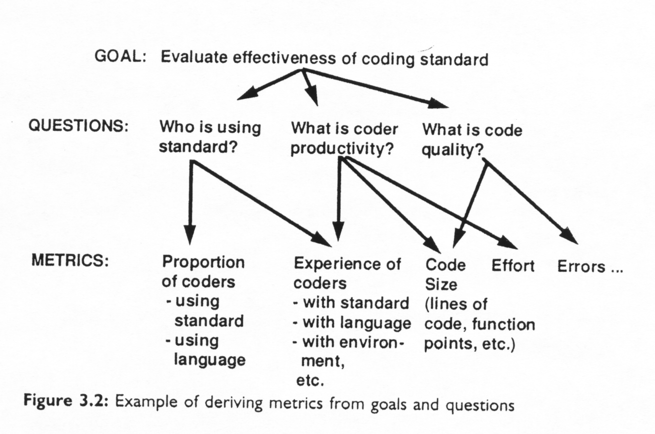
Generic GQM Example
R.Charanya, Assistant Professor,SITE, VIT Unniversity.

Slide 25
Templates for goal definition
Purpose:
  To (characterize, evaluate, predict…) the (process, model, metric…) in order to (understand, assess, manage, learn, improve…)
Perspective
  Examine the (cost, correctness, defects, changes…) from the viewpoint of (developer, manager, customer…)
Environment
  The environment consists of process factors, people factors, methods, tools, etc.
R.Charanya, Assistant Professor,SITE, VIT Unniversity.

Slide 26
GQ(I)M Process
■ 10 steps of the GQIM process
A home brewed tool to automate this process
exists(ISMS)
R.Charanya, Assistant Professor,SITE, VIT Unniversity.

Slide 27
1.Identify Business goal
The business goal can be initiated by any organizational level.
Eg: Improve customer satisfaction
Improve quality of the code
R.Charanya, Assistant Professor,SITE, VIT Unniversity.

Slide 28
2.Identify What to Know
Identifying what is needed to be known in order to understand, assess, predict, or improve the activities related to achieving goals by asking questions such as:
“What activities do we manage or execute?”
“What do we want to achieve or improve?”
Repeat these questions several times and break top-level goals down into specific things should be accomplished and issues that are needed to be addressed.
Eg:- understand , predict the material
R.Charanya, Assistant Professor,SITE, VIT Unniversity.

Slide 29
3.Identify Sub goals
Grouping related questions helps identify sub goal . In Step 3, you identify the questions that you have about the entities, then group them and identify the issues they address.
Then groupings of issues and questions translate naturally into candidate sub goals.
Eg:- Improve performance of the staff
Improve code development process
Improve quality assurance
R.Charanya, Assistant Professor,SITE, VIT Unniversity.

Slide 30
4.Identify Entities & Attribute
■ Once having a list of questions, you should examine each question and identify entities implicit in it. Then list pertinent attributes associated with each entity.
Eg :- Subgoal1: Improve the performance of our staff
Question1 : How is the overall office’s morale(confidence& courage)?
Entity: Working Environment
Attibutes: Accomadation ,Incentives,Hardware and software used, Workspace(room ,desk etc)
R.Charanya, Assistant Professor,SITE, VIT Unniversity.

Slide 31
Subgoal
Improve quality assurance
Question 1:
  Are we using manual testing or automated testing?
Entity:
  Testing method
Attributes:
  Type Name of the type
  Is used? Ys/no
R.Charanya, Assistant Professor,SITE, VIT Unniversity.

Slide 32
5.Formalize Measurement
A measurement goal (or sub goal) is a semi-formal representation of a business goal (or sub goal), composed of 4 components
  An object of interest (entity)
  A purpose
  A perspective
  A description of environment & constraints
R.Charanya, Assistant Professor,SITE, VIT Unniversity.

Slide 33
Active & Passive Measurement
Active Goals(controlling and causes changes)
  Meet the scheduled completion date
  Reduce variability
  Improve product reliability
  Improve time-to-market
  Reduce employee turn over
Passive Goals(Learning and Understanding)
  Understand the current development process
  Identify root causes
  Assess product maintainability
  Identify capabilities and trends , so that we can predict the better future performance.
R.Charanya, Assistant Professor,SITE, VIT Unniversity.

Slide 34
6.Identify Indicators
What is an indicator?
  Indicator is a display of one or more measurement results that is designed to communicate or explain the significance of those results to the user
  Why it is useful?
■ Seeing how measurement data will be displayed helps clarify exactly what must be measured.
R.Charanya, Assistant Professor,SITE, VIT Unniversity.

Slide 35
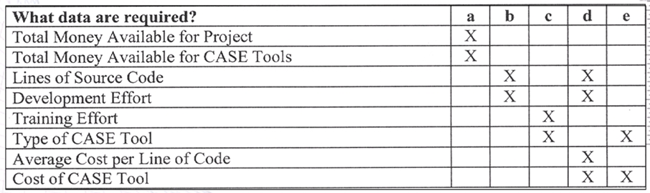
7.Identify Data Elements
Data elements that must be collected to construct the indicators identified in Step 6.
Preparing list of data item(attribute)
Definitions for data items including scales, ranges and precision will be added in the next step.
R.Charanya, Assistant Professor,SITE, VIT Unniversity.

Slide 36
8.Define Measures
What is a measure definition?
A measure definition is a semi-formal specification for the object to be measured.
Why it is useful?
It is extremely useful to clarify the implicit assumptions, what is included and what is not in the measurement.
Definitions must indicate:-
  Name and short description
  Scale
  Range of variation
  Precision required
The same applies to definitions such as:
  The measure for software size is the number of non-commented, nonblank, executable source
  statements.
R.Charanya, Assistant Professor,SITE, VIT Unniversity.

Slide 37
9.Identify Actions to Implement Measures
This step is to assemble information about the current status and use of the measures, so as to prepare a plan for implementing the measures defined, through:
Analysis-identifying the measures that the organization is using now and understanding how its collected
Diagnose-evaluate the data element , determine how well they meet the needs of new requirement
Actions-translating the results of the analysis and diagnosis into implementable steps.
R.Charanya, Assistant Professor,SITE, VIT Unniversity.

Slide 38
10.Prepare a Plan
Measurement implementation plan is based on analysis , diagnosis and actions(Step 9)
Measurement plan template includes:
  1.Objective
  2.Description
  3.Implementation-action taken to implement the measures
  4.Sustained Operations
R.Charanya, Assistant Professor,SITE, VIT Unniversity.

Slide 39
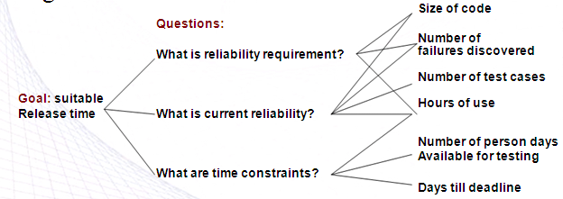
GQM Example
■ You are manager for a software development team and you have to decide upon the release time of your product. Construct a GQM tree related to this.
R.Charanya, Assistant Professor,SITE, VIT Unniversity.

Slide 40
3.2.2.Measurement and Process Improvement
Measurement can helps us to answer about the effectiveness of techniques or tools, and productivity , quality of products and more.
It allows manager and developer to monitor the effects of activities and changes on development. So that we can control the final outcome . Its useful for
  Understanding,
  Establishing a baseline
  Assessing and predicting
R.Charanya, Assistant Professor,SITE, VIT Unniversity.

Slide 41
3.2.3.Combining GQM with process maturity
High level goals
  Improving productivity
  Improving quality
  Reducing risk
Improving productivity as several sub goals affecting resources.
  Ensuring adequate managerial skills.
  Ensuring adequate staff skills.
  Ensuring adequate host software engineering technology.
Improve productivity using products can mean
  Identifying problems early in the life cycle
  Using appropriate technology
  Reusing previously built products.
R.Charanya, Assistant Professor,SITE, VIT Unniversity.

Slide 42
3.3.Applying the framework
Product , process and resources are relevant in each case , which attribute are measuring (internal or external) and whether the focus is on assessment or prediction.
R.Charanya, Assistant Professor,SITE, VIT Unniversity.

Slide 43
3.3.1.Cost and effort estimation
It focus on prediction the attribute of cost and effort.
Calculation involves based on past history , getting advice from expert judgements , etc…
Prediction
R.Charanya, Assistant Professor,SITE, VIT Unniversity.

Slide 44
3.3.2.Productivity measures and models
We measure a resource attribute , such as personnel during particular processes.
R.Charanya, Assistant Professor,SITE, VIT Unniversity.

Slide 45
3.3.3.Data collection
Work involved in data collection concerned with how to set in place for gathering accurate and insistent measures of process and resources attributes.
R.Charanya, Assistant Professor,SITE, VIT Unniversity.

Slide 46
3.3.4.Quality models and measures
Cost and productivity depend on quality of product during various processes
R.Charanya, Assistant Professor,SITE, VIT Unniversity.

Slide 47
3.3.5.Reliability models
Reliability is a likelihood of successful operation during a given period of time.
Reliability is most important quality attribute.
R.Charanya, Assistant Professor,SITE, VIT Unniversity.

Slide 48
3.3.6.Performance evaluation and models
Measuring efficiency and product attribute(time efficiency , space efficiency).
Algorithmic algorithm:-high level algorithm determine good predictor of efficiency of the implemented code , time efficiency
predictor
R.Charanya, Assistant Professor,SITE, VIT Unniversity.

Slide 49
3.3.7.Structural and complexity metrics
Single internal attribute representing complexity can be accurate predictor of many external quality attribute as well as process attribute like cost and effort.
Predictor
R.Charanya, Assistant Professor,SITE, VIT Unniversity.

Slide 50
3.3.8.Capability-maturity assessment
Maturity score is viewed as an attribute of the contractor , rather than of the contractor’s process.
R.Charanya, Assistant Professor,SITE, VIT Unniversity.

Slide 51
Determining what to measure
The SEI has suggested that there are five levels of process ranging from ad hoc, repeatable, defined, managed and optimizing.
The SEI distinguishes one level from another in terms of key process activities going on at each level.
Overview of process maturity and measurement
Maturity level | Characteristics | Type of metrics to use
5. Optimizing | Improvement feedback to the process | Process plus feedback for changing the process
4. Managed | Measured process | Process plus feedback for control
3. Defined | Process defined and institutionalized | Product
2. Repeatable | Process dependent on individuals | Project management
Initial | Ad hoc | Baseline

Slide 52
Level 1 : Initial Inputs to the process are ill-defined; while outputs are expected, the transitions from inputs to outputs is undefined and uncontrolled. Similar projects may vary widely in their productivity and quality characteristics because of lack of adequate structure and control. Baseline measurements are needed to provide starting point for measuring improvement as maturity increases.

Slide 53
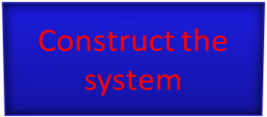
Level 2: Repeatable It identifies the inputs and outputs of the process, the constraints and the resources used in the final product. The process is repeatable: proper inputs, proper outputs, but there is no visibility into how the outputs are produced
Control
(Budget Schedule Standards)
Input Requirements
Output code Documentation
Resources (Staff Tools)
A Repeatable process

Slide 54
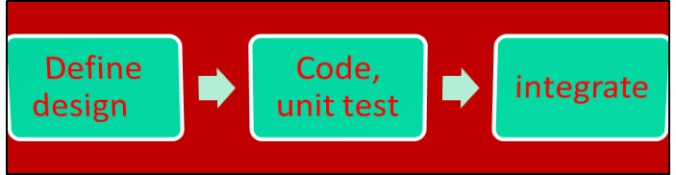
Level 3 : Defined The defined process provides visibility into the “construct the system” box In this level the intermediate activities are defined and their inputs and outputs are known and understood. All process can be examined, measured and assessed. A defined process
Design Method
Inspection criteria
Test Plans
Requirements
System S/W
Tools, Staff
Tools, Staff
Tools, Staff

Slide 55
Level 4: Managed A managed process adds management oversight to a defined process. You can compare contrast, the effects of changes in one activity can be traced in the others. The feedback determines how resources are deployed. You can evaluate the effectiveness of process activities: how effective are reviews? Configuration management? Quality assurance?. A significant difference between level 3 and 4 is that level 4 measurements reflects characteristics of the overall process and of the interaction among and across major activities. Management oversight relies on a metrics database that can provide information about such characteristics as distribution of defects, productivity and effectiveness of tasks, allocation of resources, and the likelihood that planned and actual values will match.

Slide 56
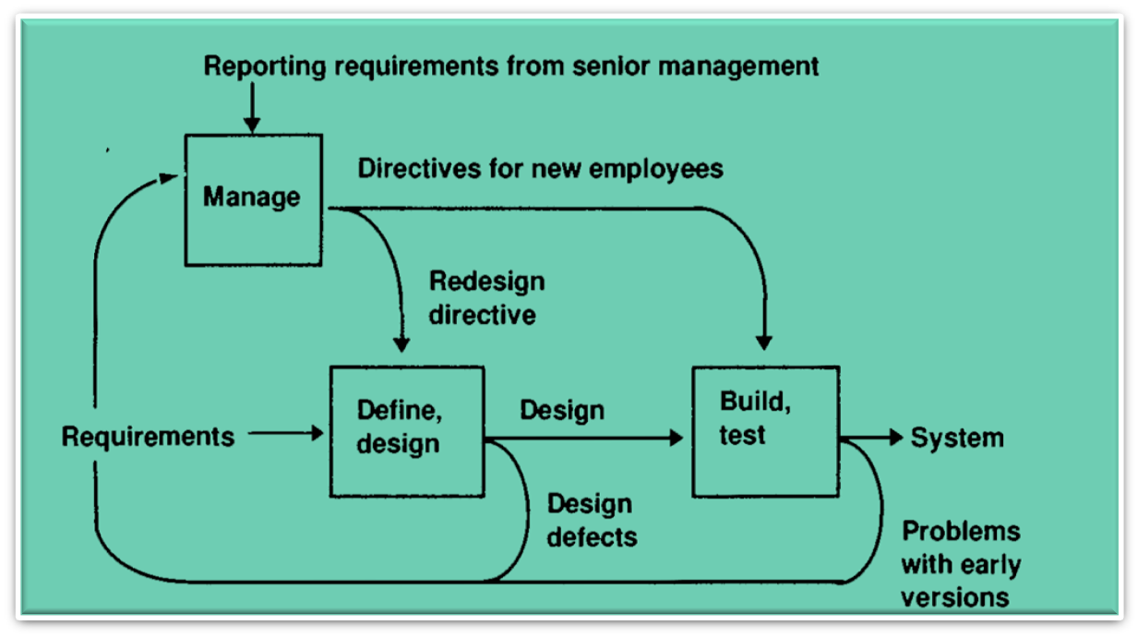
A managed process (Level 4)

Slide 57
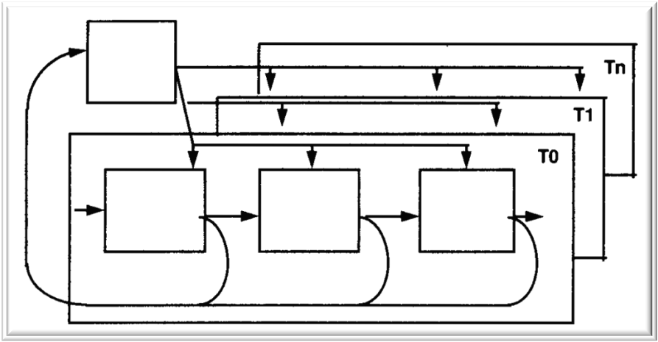
Level 5 : Optimizing Here measure from activities are used to improve process, possibly by removing and adding process activities, and changing the structure dynamically in response to measurement feedback. An optimizing process (Level 5)

Slide 58
3.9.Measurement by metrics
Management use metrics to set targets for their development projects.
Target derived from best practice.
E.g.->Existing project
R.Charanya, Assistant Professor,SITE, VIT Unniversity.

Slide 59
3.3.10.Measurement of Methods and Tools
Investing new method or tools but hesitate because of uncertainty about cost , utility, effectiveness.
Proposed tool tried in small project and result are evaluated and used for later project
R.Charanya, Assistant Professor,SITE, VIT Unniversity.

Slide 60
3.11.A Mathematician View of Metrics
In mathematical analysis ,a metric has a very specific meaning: it is a rule use to describe how far two points
Metric is a function m defined on pairs of objects x and y such that m(x,y)
It should satisfy some properties:
  M(x,y)=0
  M(x , y)=m(y , x)
  M(x,z)<=m(x,y)+m(y,z)
R.Charanya, Assistant Professor,SITE, VIT Unniversity.

Slide 61
Software Measurement Validation
Even when you know which entity and attribute you want to assess, there are many measures from which to choose.
Measures or measurement systems are used to assess an existing entity by numerically characterizing one of more of its attribute.
Prediction systems are used to predict some attribute of a future entity, involving a mathematical model with associated prediction procedures.
R.Charanya, Assistant Professor,SITE, VIT Unniversity.

Slide 62
3.4.1.Validating prediction systems
In a given environment is the process of establishing the accuracy of the prediction system by empirical means
Two prediction system
  Deterministic-get the same o/p for the given i/p
  Stochastic-output for the a given input will vary probabilistically.
R.Charanya, Assistant Professor,SITE, VIT Unniversity.

Slide 63
Measurement vs. Prediction
■ Measurement systems are used to assess existing
entities by numerically characterizing one or more
of its attributes.
■ Prediction systems are used to predict some
attributes of a future entity, involving a
mathematical model with associated prediction
procedures.
■ Deterministic prediction system: The same output will be
generated for a given input.
■ Stochastic prediction system: The output for a given input
will vary probabilistically. E.g., weather forecast.
R.Charanya, Assistant Professor,SITE, VIT Unniversity.

Slide 64
Measurement Validation
■ Validation question: Does the measure used
capture the information that it was intended
for?
■ A measure is valid if it accurately
characterizes the attribute it claims to
measure.
■ A prediction system is valid if it makes
accurate predictions.
R.Charanya, Assistant Professor,SITE, VIT Unniversity.

Slide 65
Validating Measures
■ Definition: The process of ensuring that the
measure is a proper numerical characterization of
the claimed attribute by showing that the
representation condition is satisfied.
■ Example: Measuring program length
■ Any measure of length should satisfy conditions such as:
Length of joint programs should be
m(p1 ; p2) = m(p1) + m(p2)
If length of p1 is greater that p2, any measure of length
should satisfy m(p1) > m(p2)
R.Charanya, Assistant Professor,SITE, VIT Unniversity.

Slide 66
Validating Prediction Systems
■ Definition: The process of establishing the
accuracy of the prediction system by empirical
means, i.e., by comparing model performance with
known data in the given environment.
■ Example: Software Reliability
■ Using tools such as CASRE to fit the failure data into the
reliability model.
■ Accuracy of estimation of the failure intensity λ depends
on the number of failures experienced (i.e., the sample
size).
■ Good results in estimating failure intensity are generally
experienced for programs with 5,000 or more developed
source lines.
R.Charanya, Assistant Professor,SITE, VIT Unniversity.

Slide 67
Classes of Prediction Systems
Class 1: measures of internal attributes of early life-cycle products predict measures of internal attributes of later life-cycle products
  Example: Reuse of specification are used to predict size and final code.
R.Charanya, Assistant Professor,SITE, VIT Unniversity.

Slide 68
Classes of Prediction Systems
Class 2: Measures of early life-cycle process attributes predict measures of later life-cycle processes and resources.
  Example: number of faults found during design review predict cost of implementation.
  Number of faults(old shirt damage)-predict cost of implementation(predict the cost)
R.Charanya, Assistant Professor,SITE, VIT Unniversity.

Slide 69
Classes of Prediction Systems
Class 3: Measures of internal product attributes predict process attributes.
  Example: Measures of design structure to predict maintenance effort, or the number of faults found during testing.
  Measure the design structure predict the number of faults found during testing
R.Charanya, Assistant Professor,SITE, VIT Unniversity.

Slide 70
Classes of Prediction Systems
Class 4: Measures of process attributes predict later product attributes.
  Example: 1. Measure of failure during one operational period are used to predict likely failure occurrence in the subsequent operational period.
  2. Failures during testing predict reliability in the field.
R.Charanya, Assistant Professor,SITE, VIT Unniversity.

Slide 71
Accuracy of Measurement /1
■ In an ongoing project, it is possible to validate the estimate
by comparing actual values with predicted values. If E is an
estimate of a value and A is the actual value, the relative
error (RE) in the estimate is:
A−E
RE
=
A
■ Relative error will be negative (if the estimate is greater than
the actual value) or positive (if the estimate is less than the
actual value).
■ Inaccuracies can result from either statistical variation or
estimating bias.
■ Estimating inaccuracies must be compensated for throughout
the project.
R.Charanya, Assistant Professor,SITE, VIT Unniversity.

Slide 72
Accuracy of Measurement /2
■ Relative Error (RE) can be calculated for a
collection of estimates, e.g., it is useful to determine
if predictions are accurate for a group of projects.
The mean relative error (MRE) is calculated as
the sum of RE for n projects divided by n. It is
possible for small relative errors to balance out
large ones, so the magnitude of the error can also be
considered.(Sum of RE(n)/n)
■ The mean magnitude of relative error (MMRE)
is calculated using the absolute value of RE.
R.Charanya, Assistant Professor,SITE, VIT Unniversity.

Slide 73
Accuracy of Measurement /3
■ MMRE is used to define prediction quality.
■ On a set of n projects, if k is the number of projects
whose RE is less than or equal to q, then prediction
quality is calculated as:
PRED(q) = k/n
■ Example:
■ PRED(0.25) = 0.47 means that 47% of the predicted
values fall within 25% of their actual values.
■ An estimation technique is (usually) acceptable if
PRED(0.25) = 0.75 .
R.Charanya, Assistant Professor,SITE, VIT Unniversity.

Slide 74
Exercise
■ Assume you want to predict the error proneness of
software modules.
a) How would you assess prediction accuracy?
RE (relative error) = (A - E) / A
with A: actual, E: estimated
MRE
=
1
n
n
∑REi
i=1
MMRE
=
∑
RE
1
n
n
i
i=1
b) How would you assess prediction quality?
PRED(q) = k/n
where k is the number of predictions with |RE|<=q
R.Charanya, Assistant Professor,SITE, VIT Unniversity.

